Slide 1
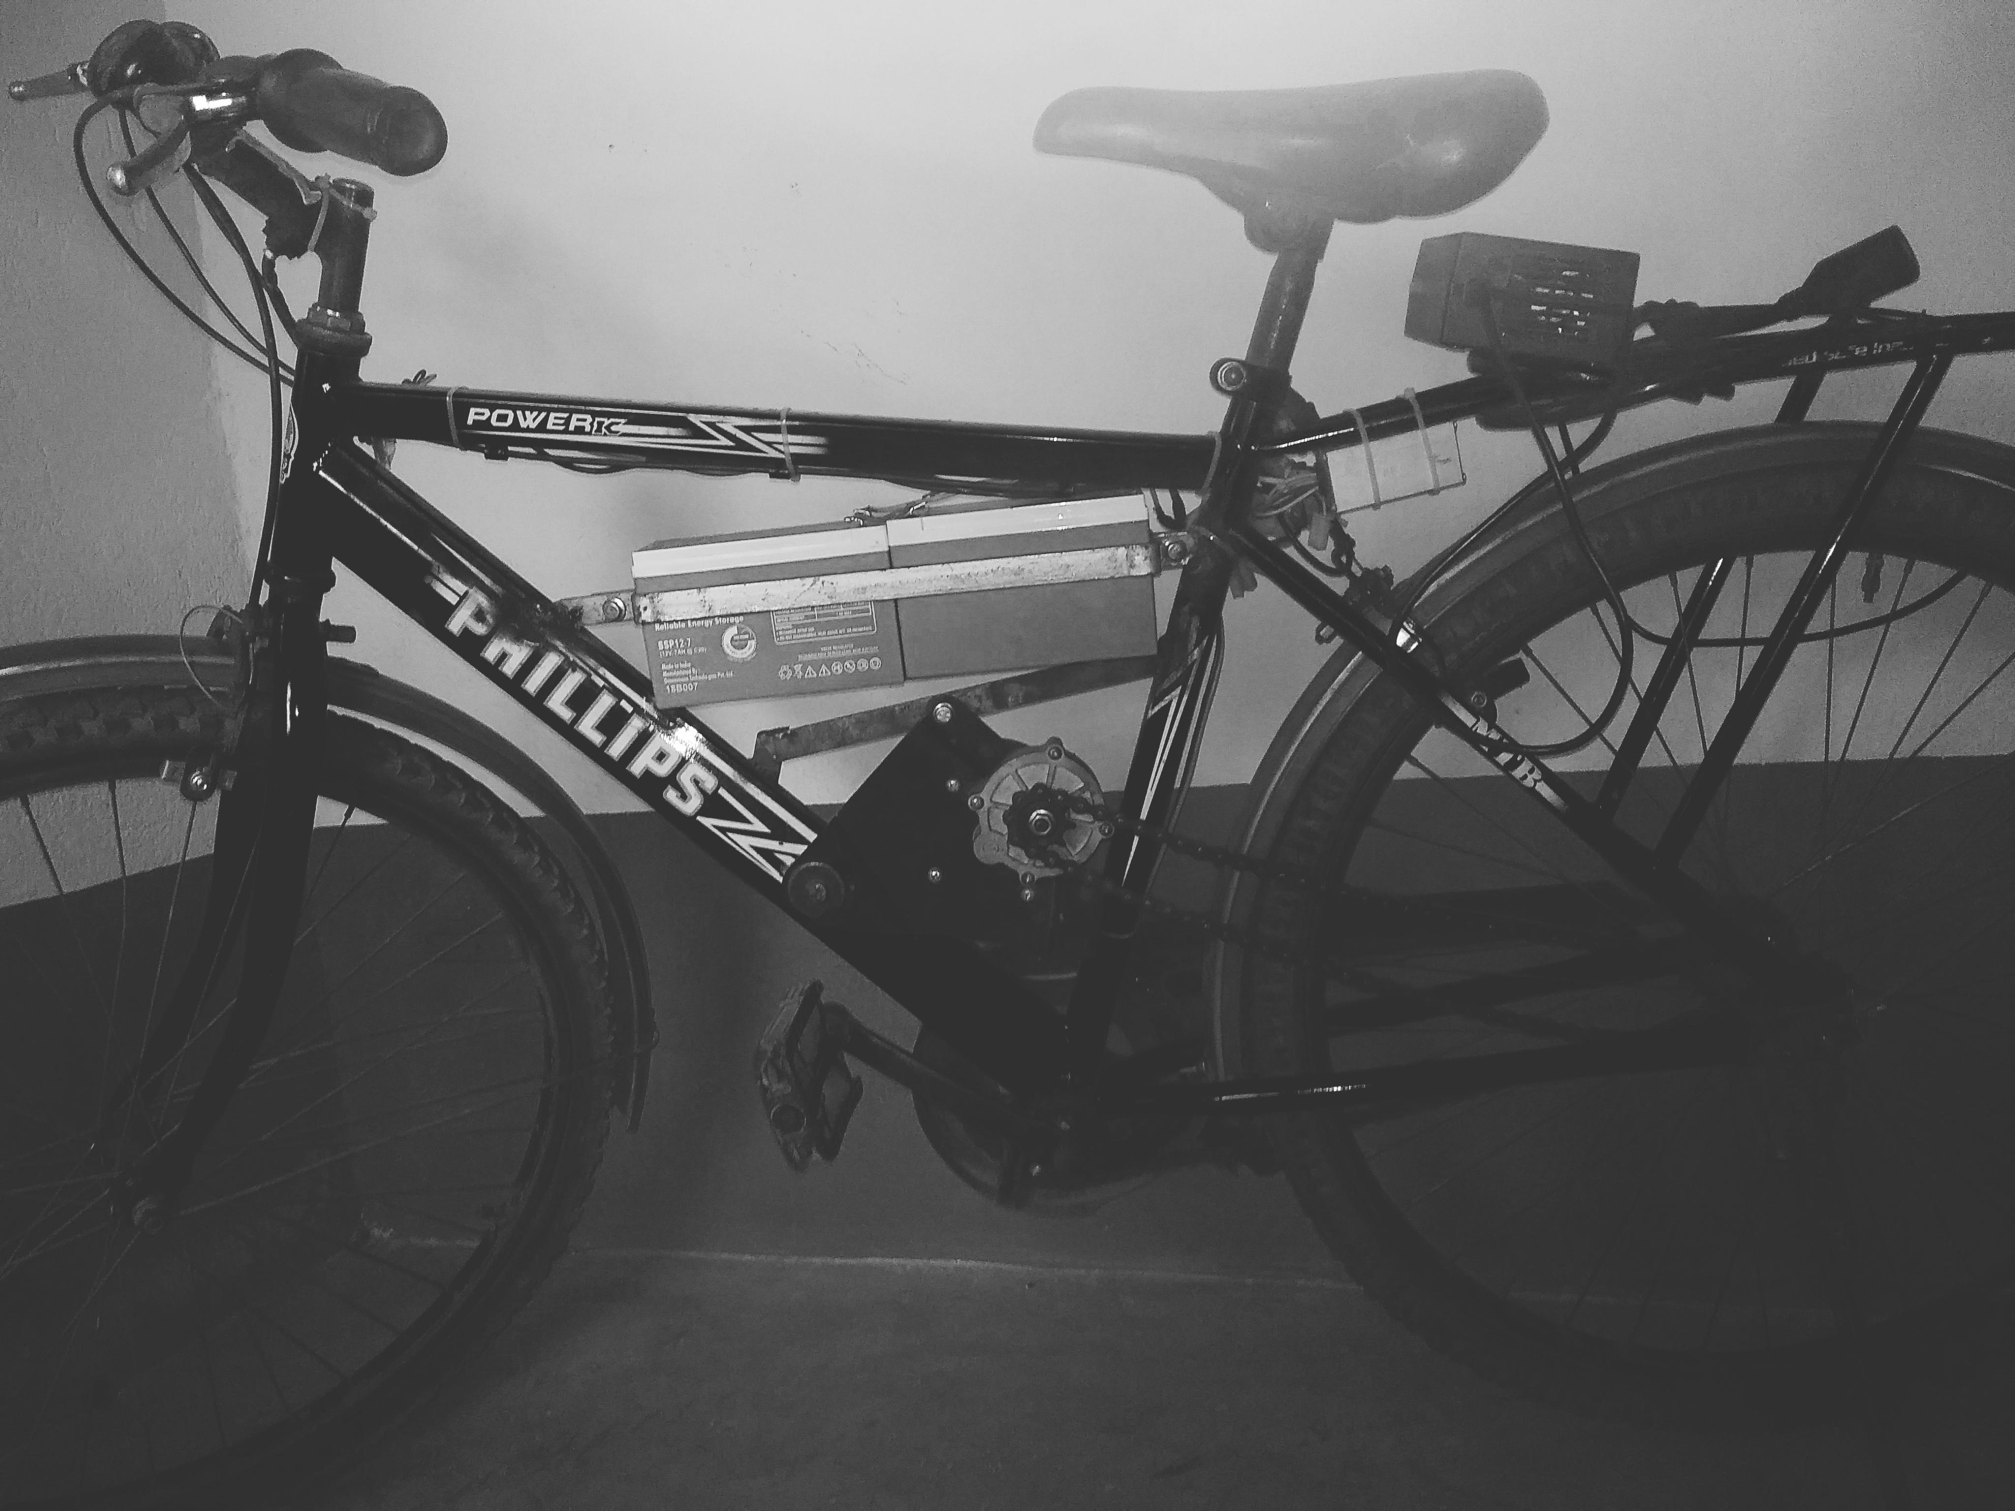
Seacom Engineering College
A Seminar on
. “ PEDELECS”
Presented by-
Susmit Jana ~20600114016
Rahul Singh~20600114010
Atmaprakash das~20600115018
Deep mukherjee~ 20600115020

Slide 2
Content
Introduction
History
Classes
Working
Market presentation
Technical Description
Advantages and disadvantages
Conclusion

Slide 3
Introduction
An electric bicycle, also known as an e-bike it has integrated electric motor which can be used for propulsion.
It has great variety of different featuress but some common are:-
Bicycle mounted ultrasonic distance sensor for monitoring road surface condition.
Bluetooth module
Automatic headlights dimming using LDR
Ebike uses rechargable bbattery can travel up to 25 to 32 km/h depending on the laws of the country in which they are sold, while the more high-powered varieties can often do in excess of 45 km/h (28 mph).

Slide 4
History
In 1890s, electric bicycles were documented within various u.s. Patents.
On 31st December 1895, Ogden Bolton jr. Was granted u.s. Patent 552,271 for a bettary powered bicycle. There is no gears and the motor could draw up to 100 amperes from a 10-volt battery.
Two years later, in 1897 , Hoesa w. Libbey of Boston invented an electric bicycle that has propelled by a ‘double electric motor”.(u.s. Patent 596,272)

Slide 5
Classes
Ebikes are classed according to the power that their electric bike motor can deliver and the control system, i.e, when and how the power from the motor is applied with padal-assist the electric motor is regulated by paddling. The pedal assist augments the effort of the rider when they are paddling. These ebikes are called padelecs – have a sensor to detect the speed, force, distance etc. Brake activation is sensed to disable the motor as well.
With power –on-demand the motor is activated by a throttle, usually handlebar-mounted just like on motorcycles and scooters.

Slide 6
Working
A battery produces energy that transfer to kinetic energy in the tyres and move them forward.

Slide 7
Market presentation
Ebike usage worldwide has experienced rapid growth since 1998. It is estimated that there were roughly 120 million ebikes in China in early 2010, and sales are expanding rapidly in India, the united states of America, the Netherlands, and Switzerland.
A total of 700,000 ebikes were sold in Europe in 2010, up from 200,000 in 2007 and 500,000 units in 2009.
Today , China is the world’s leading producer of e-bikes.

Slide 8
Technical Description
Motor
Batterie
Controller
Ultrasonic sensor Using Arduino nano

Slide 9
Motor
The two most common types of motors used in elevtric
Bicycles are brushed and brushless. There are many possible type of electric motorized cycles with several technologies Available, varying in cost and complexity; direct drive and geared motor units are both used.

Slide 10
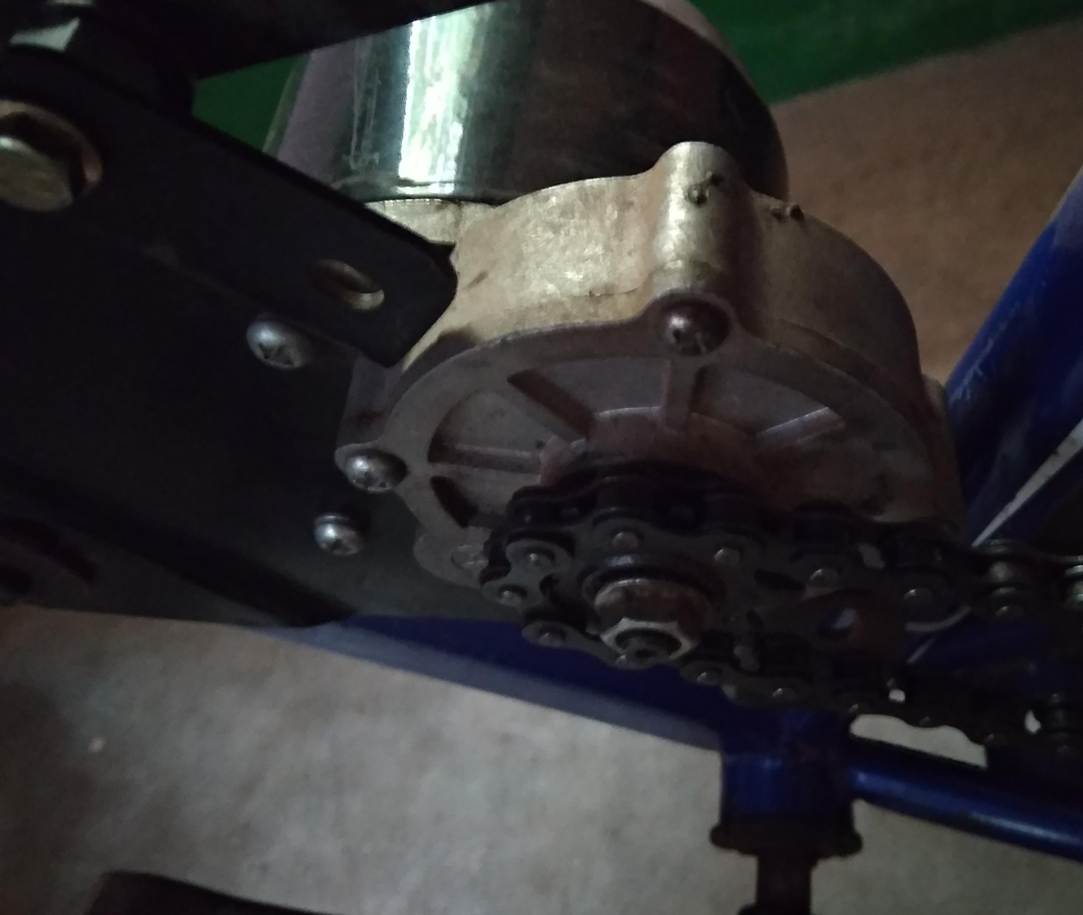
Motors
My8029 24DC motor

Slide 11
2. Battery
Ebikes use rechargable batteries, electric motors and some form of control.
Battery systems in use include sealed lead acid (SLA), nickel-cadmium (NiMH), or lithium Ion polymer (Li-ion).
Batteries vary according to the voltage, total charge capacity (amp hours), weight the number of charging cycles before performance degrades, an ability to handle over-voltage charging conditions.

Slide 12
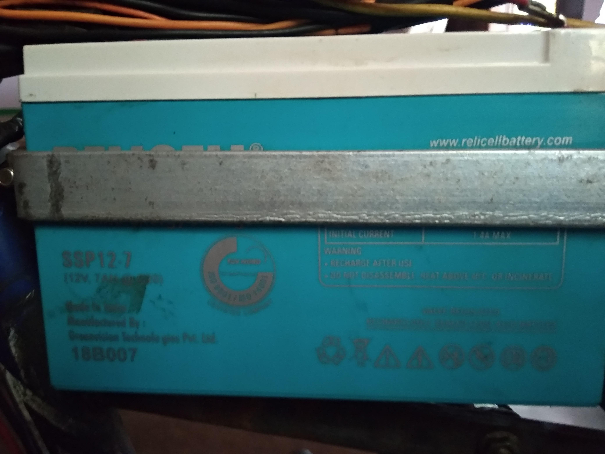
Battery
12v sealed lead acid battery

Slide 13
3. Controller
There are two types of controller designed to match either a brushed motor or brushless motor.
Controller for brushless motors: it have hall sensors communicating for speed measurement. The controllers generally provided potentiometer adjustable motor speed, protection logic for over voltage, over current and thermal protection.the controller uses pulse width modulation to regulate the power to to the motor.
Controller for brushed motor: they are also in ebikes but are becoming less common Due to their instrinsic lower efficiencie. Controller for brushed motor however are much simpler and chipper due to the Fact they don’t require hall sensor feedback.

Slide 14
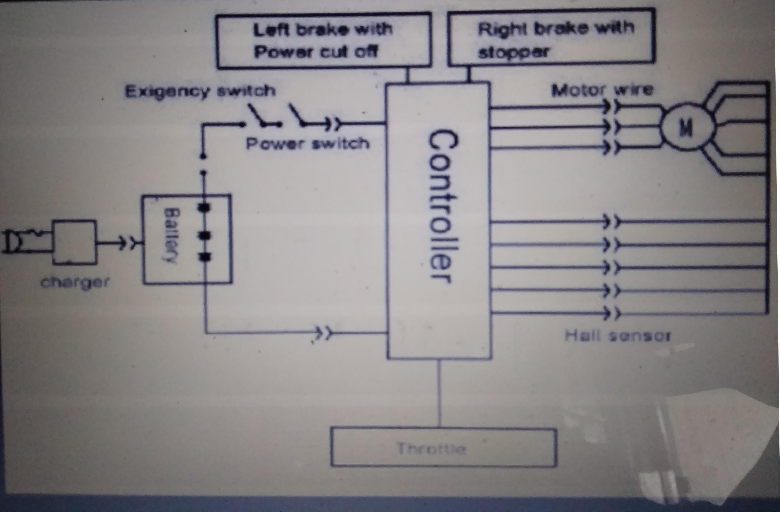
Controller

Slide 15
Advantages & disadvantages
Advantages:-
Easy to use.
Smooth and silent.
Non polluting and eco friendly.
Zero emission
It requires non exhaustible fuel resource.
Disadvantages:-
low speed
Can’t travel for distances above 120km.
Instant charging is not possible always.
Can’t carry weight more than 200 kg.

Slide 16
Conclusion
Purchase electric bike and save our mother earth.
It’s you.......... Who can stop pollution and start a revolution.

